Slide 1

CONTRACT MONTHLY CLAIM SYSTEM ST10279488 PROG6212 POE

Slide 2
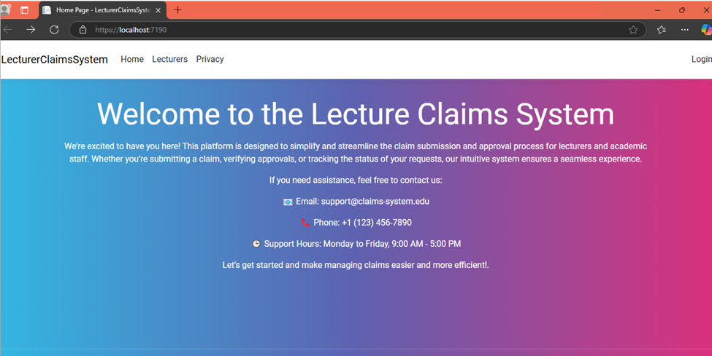
Home Page Overview
Our homepage is designed to create a welcoming and user-friendly entry point for the Contract Monthly Claim System.
Key features include:
Welcome Message: A warm introduction to make users feel invited and guide them on the system's purpose and functionality. This ensures accessibility for all users, even those new to the platform.
Contact Details: Easily accessible contact information for support or inquiries, enhancing user trust and providing immediate assistance if needed.
Navigation Bar (Navbar): A sleek and intuitive navigation bar that provides links to all key sections of the system, including:
Claim Submission
Pending Approvals
Document Upload
Claim Status Tracking The navbar ensures quick and seamless navigation across the platform, saving users time and improving efficiency.
Why It Matters: The homepage is thoughtfully designed to ensure clarity, simplicity, and ease of use. It acts as a central hub, helping users access essential functions quickly and making the overall experience engaging and efficient.

Slide 3
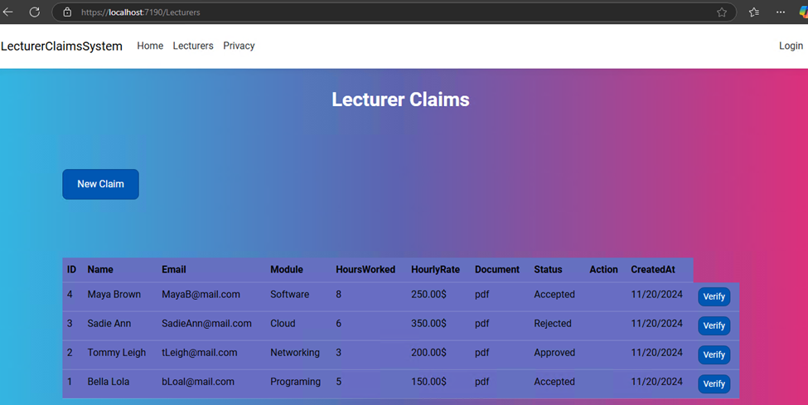
Lecturer Claims Page
The Lecturer Claims Page is a core component of the Contract Monthly Claim System, empowering lecturers to efficiently manage their claims.
Key Features:
User-Friendly Form: Fields for hours worked, hourly rate, and notes, with a clear 'Submit' button.
Document Upload: Securely attach supporting files (PDFs, Word, Excel) to ensure complete submissions.
Real-Time Feedback: Instant confirmation or error messages for seamless submissions.
Benefits:
Simplifies claim submission and eliminates paperwork.
Ensures accuracy with structured fields.
Saves time with an intuitive, fast interface.

Slide 4
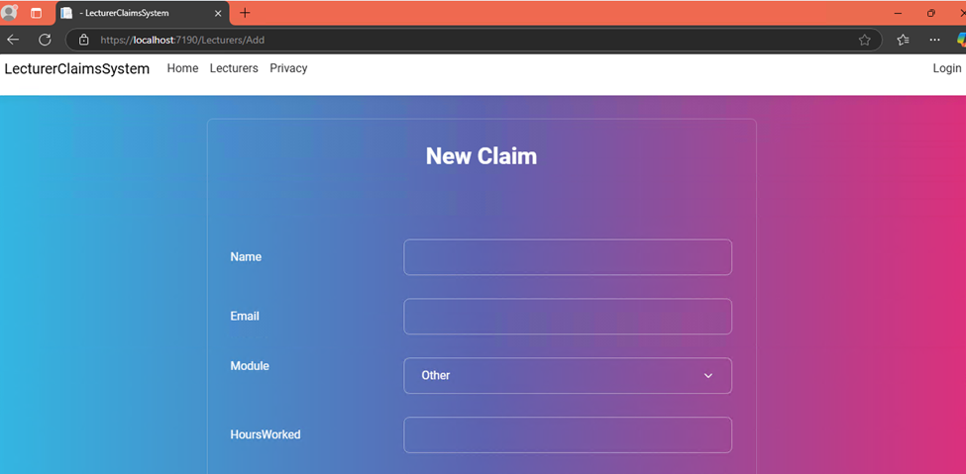

New Claim Page
The New Claim Page provides an intuitive and efficient interface for submitting new claims.
Key Features:
Simple Form Design:
Fields for hours worked, hourly rate, and additional notes.
Clear and accessible 'Submit' button for easy interaction.
File Upload Option:
Securely attach supporting documents (PDF, Word, Excel).
User Guidance:
Real-time validation with clear messages for errors or successful submissions.
Benefits:
Ease of Use: Simplifies the process for lecturers.
Improved Accuracy: Structured inputs reduce errors.
Time-Efficient: Quick and reliable for busy users.

Slide 5
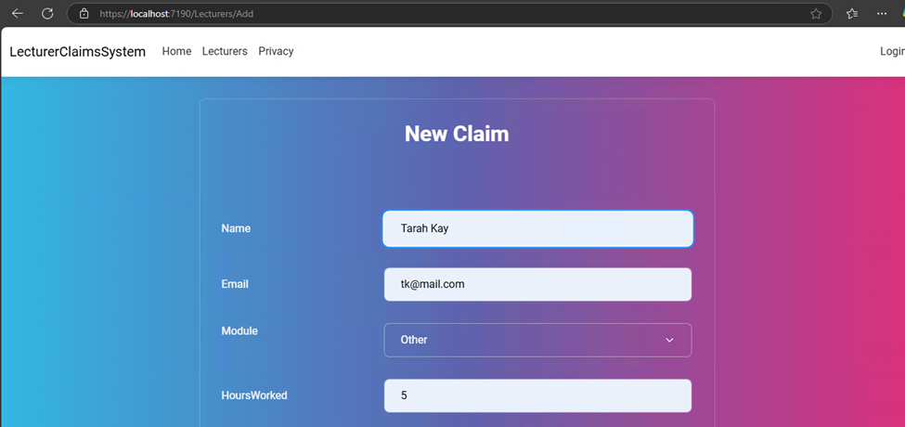

Inputting details to create a new claim
Once all lecturer claim details have been entered the lecturer can click submit and they will be redirected to the Lecturer Claims page with their updated claim showing on the list.
If they choose to click cancel the details will be erased and they will be redirected to the Lecturer Claims page to see that nothing has changed.

Slide 6
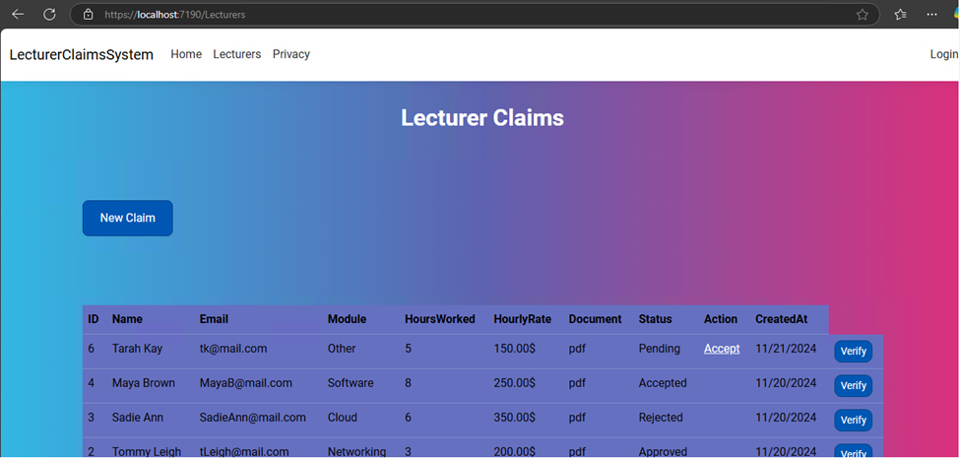
Updated Lecturer Claims Page
New Claim Submission:
Simple form to add details like hours worked, hourly rate, and additional notes.
Option to attach supporting documents securely.
Updated Claim Management:
View and edit previously submitted claims.
Real-time status updates for pending, approved, or rejected claims.
Benefits:
Centralized Access: All claims, both new and existing, are managed in one place.
Enhanced Flexibility: Easy updates to claims if corrections are needed.
Streamlined Workflow: Reduces errors and processing delays.

Slide 7
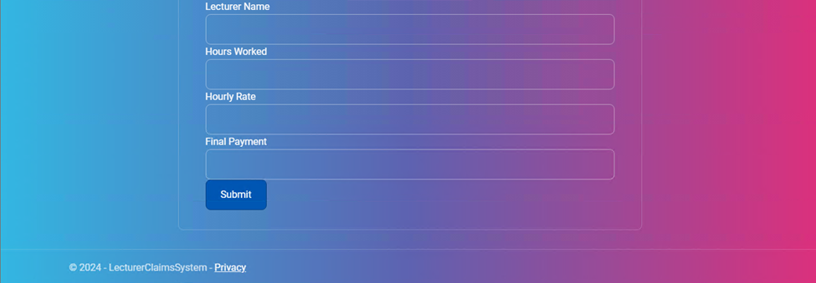
Auto-Calculation Page
The Auto-Calculation Page enhances accuracy and efficiency by automatically computing claim totals.
Key Features:
Dynamic Calculations:
Automatically calculates total claim amounts based on hours worked and hourly rate.
Updates in real-time as values are entered.
Error Prevention:
Ensures no manual miscalculations by validating entries instantly.
User-Friendly Interface:
Clearly displays calculated totals in an easy-to-read format.
Benefits:
Accuracy: Eliminates calculation errors.
Time-Saving: Reduces the time spent on manual computations.
Improved Usability: Provides instant feedback for user convenience.

Slide 8

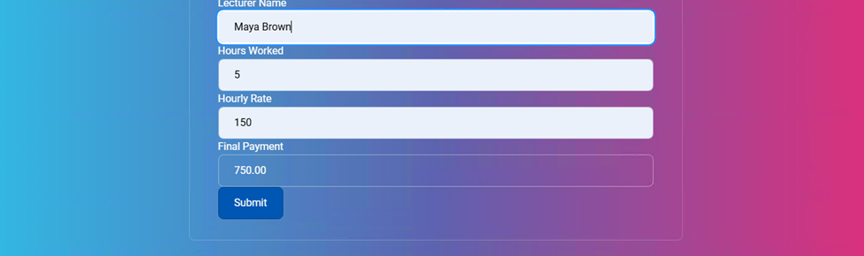
Input Data: The lecturer enters hours worked and hourly rate.
Auto Calculation: The system instantly calculates the total and displays it for review.
Redirect: After submission, the user is redirected to the Lecturer Claims Page, where the new claim appears with updated information.

Slide 9
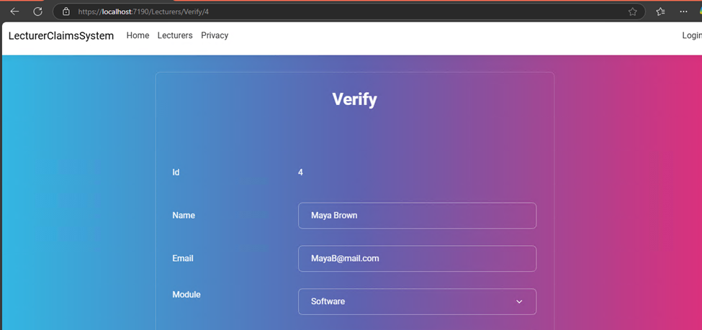

Approve and Verify Page (HR View)
The Approve and Verify Page is designed for HR personnel to efficiently manage claims by verifying details and approving or rejecting submissions.
Key Features:
Claims Dashboard:
Displays a comprehensive list of all submitted claims, with key details such as lecturer name, hours worked, claim amount, and status.
Includes filtering and sorting options for easier navigation.
Verification Tools:
Allows HR to review claim details and attached documents for accuracy and completeness.
Provides fields for adding notes or comments during verification.
Approval Workflow:
Simple buttons to Approve or Reject claims, instantly updating the claim status.
Automatic notifications sent to lecturers about the status change.
Benefits:
Streamlined Processes: Centralizes claim management, saving time and effort.
Transparency: Ensures a clear and auditable approval process with recorded notes and decisions.
Improved Communication: Keeps lecturers informed with real-time updates on their claims.

Slide 10

THANK YOU
ST10279488
GitHub Link: https://github.com/ST10279488/PROG6212-ST10279488-POE.git

